Slide 1
The lecture 8
Subclass processes

Slide 2
Processes
To implement a custom subclass and process, we must:
Define a new subclass of the Process class
Override the _init__(self [,args]) method to add additional arguments
Override the run(self [,args]) method to implement what Process should when it is started
Once you have created the new Process subclass, you can create an instance of it and then start by invoking the start() method, which will in turn call the run() method.

Slide 3
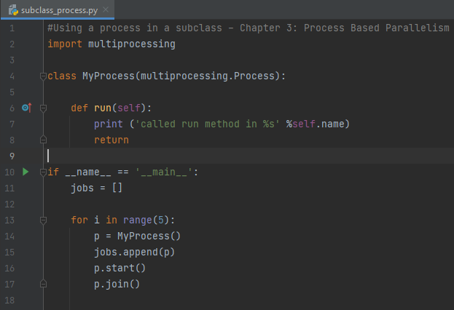
Subclass process

Slide 4
Myprocess
Each Process subclass could be represented by a class that extends the Process class and overrides its run() method. This method is the starting point of Process:
class MyProcess (multiprocessing.Process):
def run(self):
print ('called run method in process: %s' %self.name)
return
In the main program, we create several objects of the type MyProcess(). The execution of the thread begins when the start() method is called:
p = MyProcess()
p.start()
The join() command just handles the termination of processes.

Slide 5
Processes synchronization
Multiple processes can work together to perform a given task. Usually, they share data. It is important that the access to shared data by various processes does not produce inconsistent data. Processes that cooperate by sharing data must therefore act in an orderly manner in order to access that data. Synchronization primitives are quite similar to those encountered for the library and threading.
They are as follows:
Lock: This object can be in one of the states: locked and unlocked. A lock object has two methods, acquire() and release(), to manage the access to a shared resource.
Event: This realizes simple communication between processes, one process signals an event and the other processes wait for it. An Event object has two methods, set() and clear(), to manage its own internal flag.
Condition: This object is used to synchronize parts of a workflow, in sequential or parallel processes. It has two basic methods, wait() is used to wait for a condition and notify_all() is used to communicate the condition that was applied.
Semaphore: This is used to share a common resource, for example, to support a fixed number of simultaneous connections.
RLock: This defines the recursive lock object. The methods and functionality for RLock are the same as the Threading module.
Barrier: This divides a program into phases as it requires all of the processes to reach it before any of them proceeds. Code that is executed after a barrier cannot be concurrent with the code executed before the barrier.

Slide 6
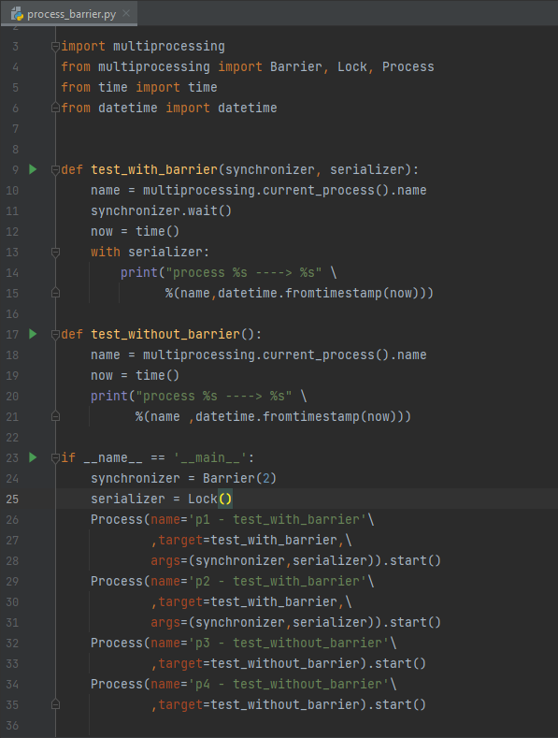
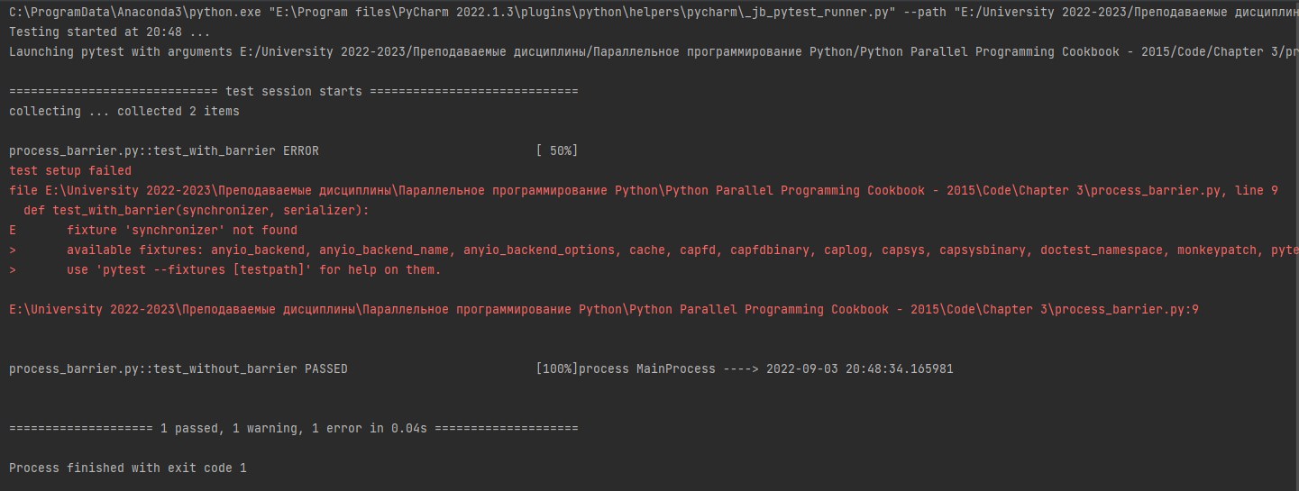
Processes synchronization

Slide 7
Processes synchronization
In the main program, we created four processes; however, we also need a barrier and lock primitive. The parameter 2 in the barrier statement stands for the total number of process that are to be managed:
if __name__ == '__main__’:
synchronizer = Barrier(2)
serializer = Lock()
Process(name='p1 - test_with_barrier’\
,target=test_with_barrier,\
args=(synchronizer,serializer)).start()
Process(name='p2 - test_with_barrier’\
,target=test_with_barrier,\
args=(synchronizer,serializer)).start()
The test_with_barrier_function executes the barrier's wait()method:
def test_with_barrier(synchronizer, serializer):
name = multiprocessing.current_process().name
synchronizer.wait()
When the two processes have called the wait() method, they are released simultaneously:
now = time()
with serializer:
print("process %s ----> %s" %(name \
,datetime.fromtimestamp(now)))

Slide 8
Processes synchronization
The following figure shows you how a barrier works with the two processes

Slide 9
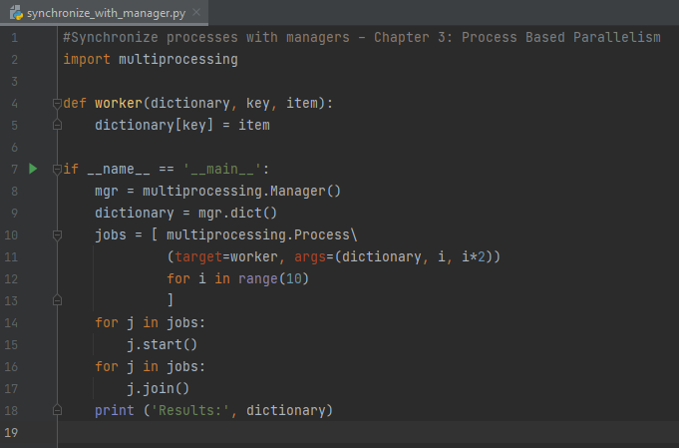
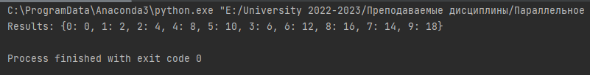
Processed based parallelism
Python multiprocessing provides a manager to coordinate shared information between all its users. A manager object controls a server process that holds Python objects and allows other processes to manipulate them.
A manager has the following properties:
It controls the server process that manages a shared object
It makes sure the shared object gets updated in all processes when anyone modifies it

